Slide 1
AGTECHATHON 1.0 – Idea Submission
Project - Title : TRIP CRAFT
Your very own Travel Itinerary Planner
WALCHAND INSTITUTE OF TECHNOLOGY
SOLAPUR
Computer Science & Engineering
Team Members
Aditi Deshpande Priyanka Sundalam Ankita Advitot Tejas Jahagirdar

Slide 2
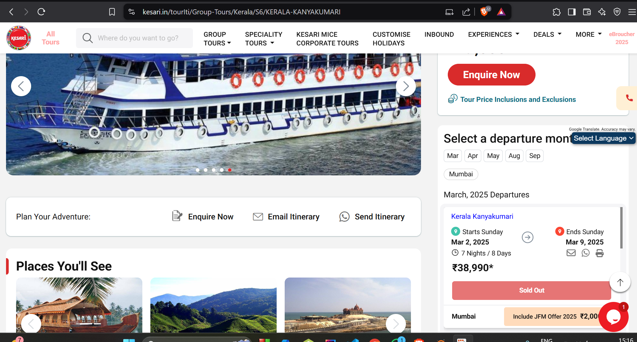
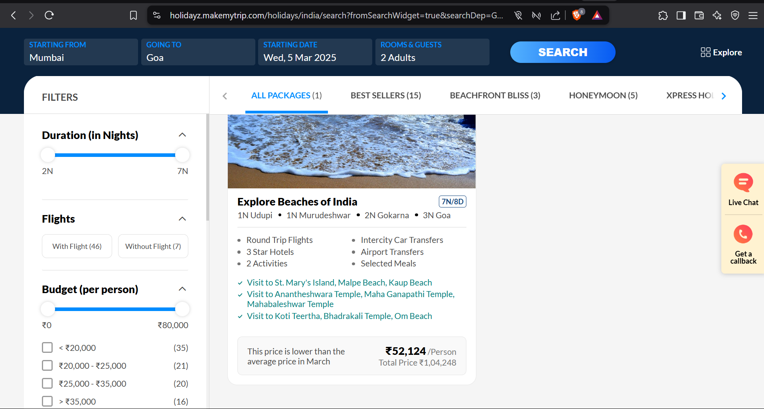

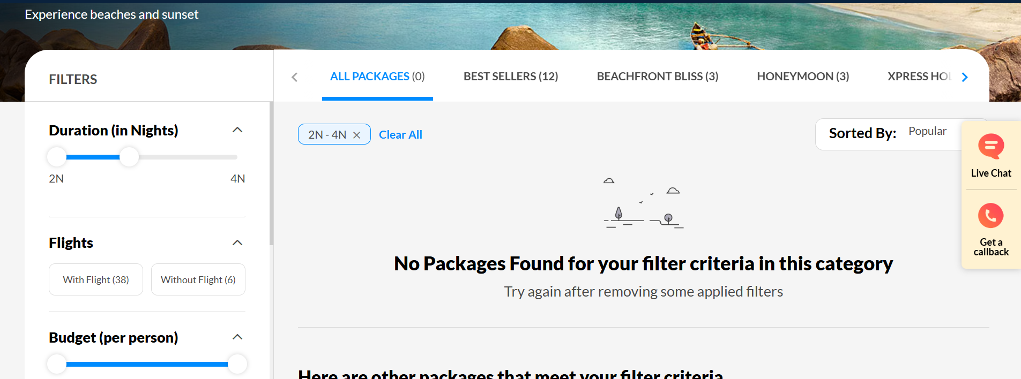
Trip Craft : Your Very Own Travel Planner
Problem Statement
Planning a trip can be overwhelming due to extensive research on destinations, budgets, and many more conditions.
Travelers face challenges with unexpected changes, lack of personalized recommendations, and difficulty collaborating.
A smart solution is needed to simplify planning, enhance personalization, and adapt in real time for a hassle-free experience.
Last moment plans sold out😱
No packages available as per our preference😓
High prices!!!!!!!

Slide 3

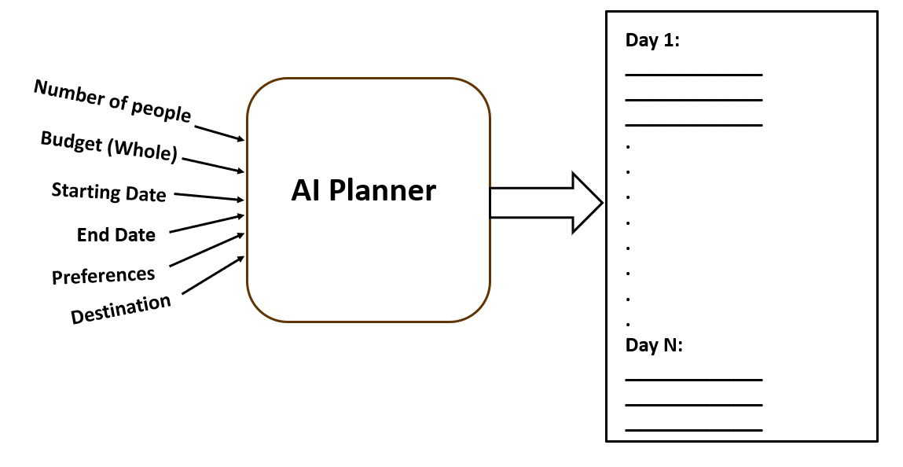
Trip Craft : Your Very Own Travel Planner
Proposed Solution
Trip Craft simplifies planning by handling research, adapting to real-time changes, and enabling collaboration effortlessly.​
Smart & Adaptive Planning
Flexible & Effortless
Seamless Collaboration
Budget-Friendly Travel
Engaging Travel Community
Trip Craft makes travel planning effortless, personalized, and stress-free—so users can focus on enjoying their journey.​

Slide 4
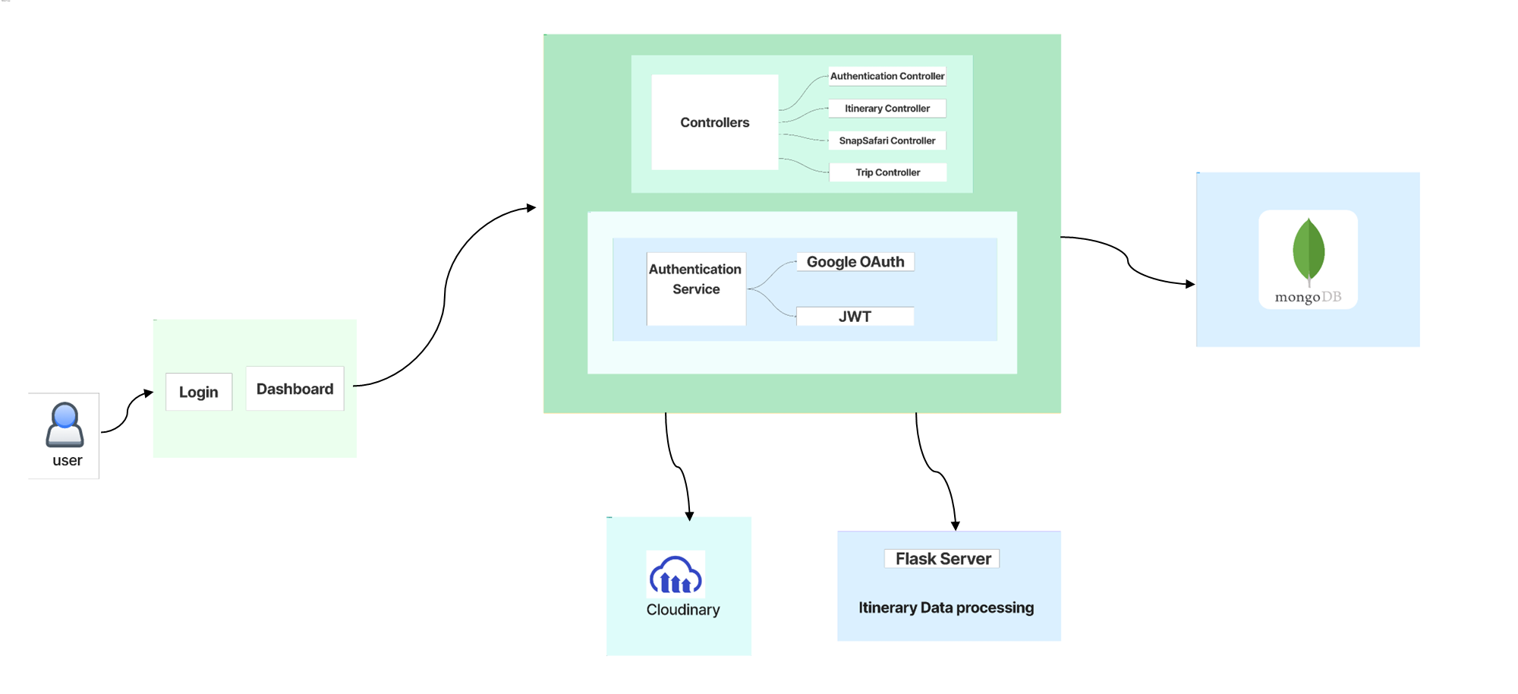
Trip Craft : Your Very Own Travel Planner
System Architecture

Slide 5
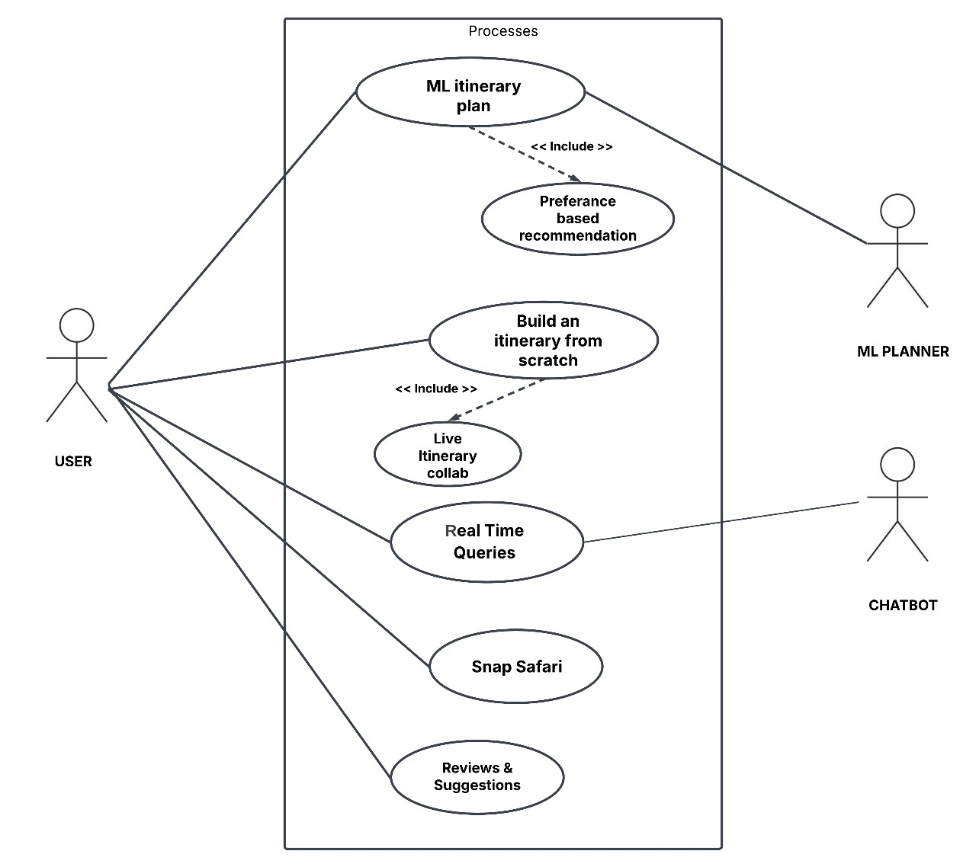
Trip Craft : Your Very Own Travel Planner
Use case diagram
Actors:
User
Chatbot
AI planner
Process:
AI Itinerary planner ​
Build an Itinerary from scratch
​
Snap safari ​ ​
Reviews & Suggestions ​

Slide 6










Trip Craft : Your Very Own Travel Planner
Trip Craft : Your Very Own Travel Planner
Technologies used​
Frontend
Backend
API
AI
HTML
Java
Gemini API
Python
Springboot
CSS
Machine Learning
MongoDb
React.js
Cloudinary

Slide 7
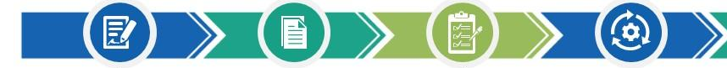




Trip Craft : Your Very Own Travel Planner
AI-Powered Travel Itinerary Planner:
AI-driven tool that adjusts travel itineraries in real time based on trending travel hotspot patterns.
Plan from Scratch: Enables travelers to build fully custom itineraries manually, offering total control over every destination, activity, and time slot.
UNIQUE FEATURES
Snap Safari :
Users can post travel photos, similar to an Instagram-style experience.
Live Itinerary Collaboration:
Enables multiple users to co-create, edit, and share travel plans in real-time, ensuring seamless
coordination and
personalized itineraries
for group trips.
BENEFITS
Saves Money Travel Expenses:
Predicts the best time to book flights and hotels.
Enhances Travel Experience – Allows travelers to focus on experiences rather than money management.
Improves Trip Planning Efficiency:
Reduces time spent on budgeting and booking.
Reduces Financial Stress – Eliminates worries about running out of money during trips.

Slide 8




Trip Craft : Your Very Own Travel Planner
Future Scope
Sustainable Travel Suggestions: Suggest eco-friendly stays, green transport options, and practical tips to help travelers reduce their environmental impact and travel responsibly.
Hidden Gems: Recommend lesser-known, unique destinations and experiences curated for adventurous travelers.
Find a Friend: Connect solo travelers with like-minded individuals for shared experiences and group activities.
Real-Time Language Translation: Integrate a tool for instant translation of menus, signs, and conversations.

Slide 9
Trip Craft : Your Very Own Travel Planner
Research & References
Make my trip : https://www.makemytrip.com/holidays-india/
Kesari :
https://www.kesari.in/
Yatri :
https://www.yatra.com/
ScienceDirect:
https://www.sciencedirect.com/science/article/pii/S1877050924008585
MongoDB – NoSQL Database
https://www.mongodb.com/docs/manual/introduction/

